Slide 1
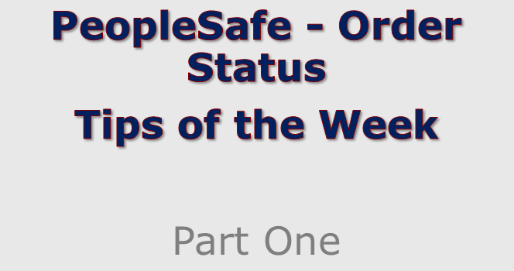

Slide 2


Slide 3
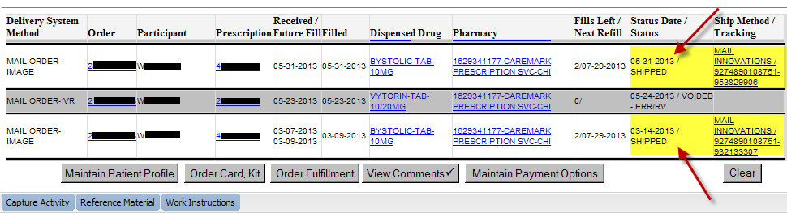

Provide ship date, method and tracking information if available.
Always verify address on the Order Status screen to make sure it went to the right place.
Note: Change selector to "All" if order does not immediately show up on main screen
Reminder: Just because PeopleSafe says the order is shipped, doesn’t mean it is on the truck yet! Check to see what time the order completed (on Prescription Details screen). For more info, see the ORDER STATUS work instruction and search (CTRL-F) for “Shipped”.
Click to move on

Slide 4
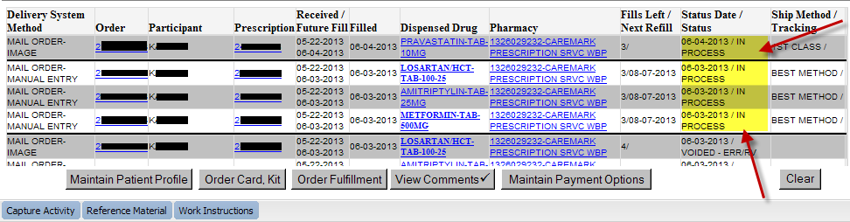

We are working on the order. It is within our normal turnaround times.
If member shows any sign of concern or asks for more details, click the Order Number to see more details on the Order Status screen. (coming in part 2!)
Click to move on

Slide 5
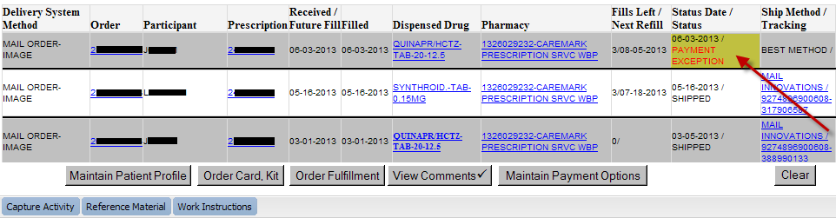

There is a payment issue. Look up the details on the Order Status screen and ask the member for the necessary information to resolve the issue.
See “Order Status – Payment Exceptions” in CareSource for a how-to guide.
Click to move on

Slide 6
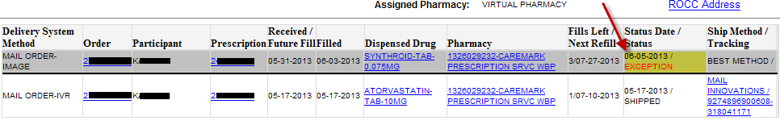

This means the order has exceeded an “internal due date”. This date is set by client expectations and can vary - it could be as low as 2 days. Remember we do not communicate this date to members!
It does NOT mean there is something wrong with the order. Do not panic or cause the member alarm until you have checked all the details on the Order Status screen.
Click to move on

Slide 7
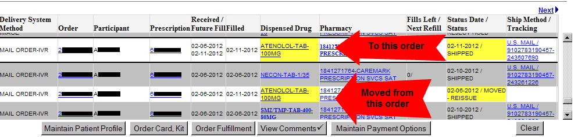

This means the prescription was moved to another order. Check for a newer order for the medication. It should have the same prescription number.
If the member was expecting multiple prescriptions in one order, let them know that they will receive two (or more) shipments.
Click to move on

Slide 8
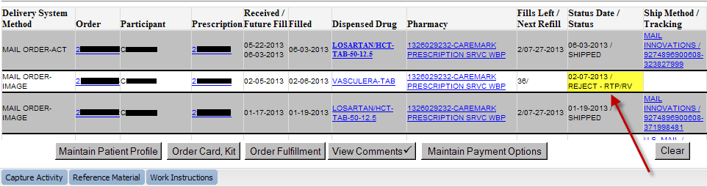
In all cases, we couldn’t fill the prescription.
Reject-RTP: An RTP letter will be sent to the member explaining why RX was not filled. Ex: Drug not covered or not available at mail service
Reject-DPR: There was a problem with the prescription that needed verification from the prescriber. Ex: Missing instructions or illegible quantity
Reject-Hold: The prescription was placed on indefinite hold. Ex: Member asked us to not fill the prescription at this time.
Click to move on

Slide 9
Hope you enjoyed this installment of order status tips. Stayed tuned for Part 2 coming soon!

